Slide 1

Analysis of T-20 World Cup 2022 Data
An Overview of the Project

Slide 2
Data Preprocessing
The dataset T-20 World cup 2022.csv was loaded into a pandas DataFrame. The following steps were performed for data preprocessing:
We handle missing values differently for numerical and categorical columns, filling them with mean and mode respectively.
Columns with a high percentage of missing values are dropped.
After cleaning, the dataset is ready for further analysis.

Slide 3
Data Exploration
Data exploration helps us understand the performance of teams and players during the tournament.
We analyze team-wise performance metrics, identifying trends and patterns in runs scored and wickets taken.

Slide 4
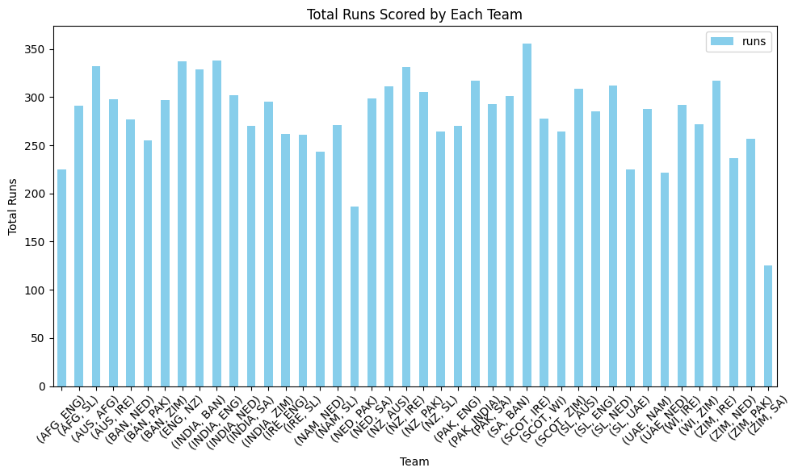
Runs Scored
A bar plot is used to visualize the total runs scored by each team.
This visualization highlights the top-performing teams in terms of batting prowess.

Slide 5
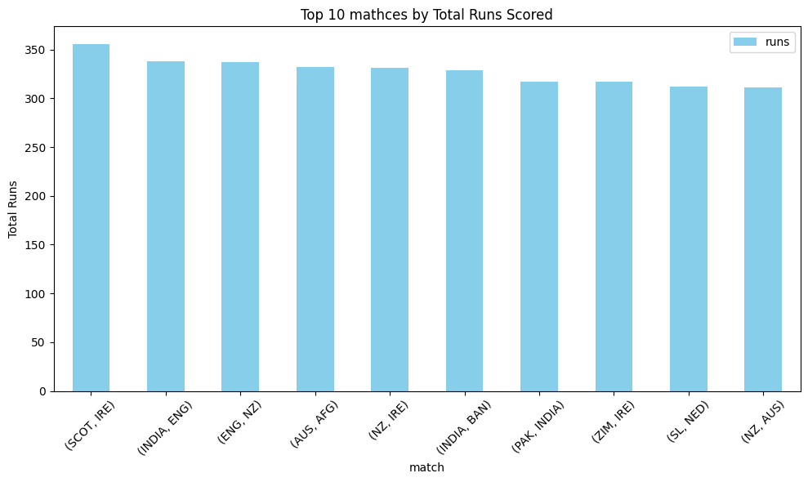
Top 10 Matches by Total Runs
Another bar plot showcases the top 10 matches by total runs scored.
We identify high-scoring matches and examine the factors contributing to their outcomes.

Slide 6
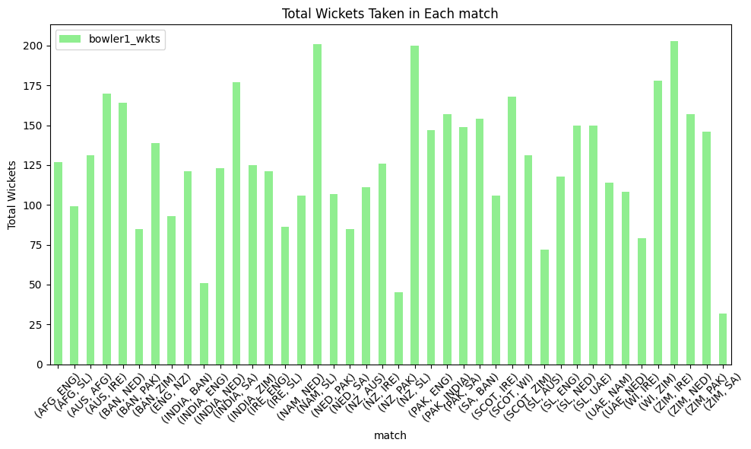
Wickets Taken
We use a bar plot to display the total wickets taken by each team.
This visualization sheds light on the bowling strengths of different teams.

Slide 7
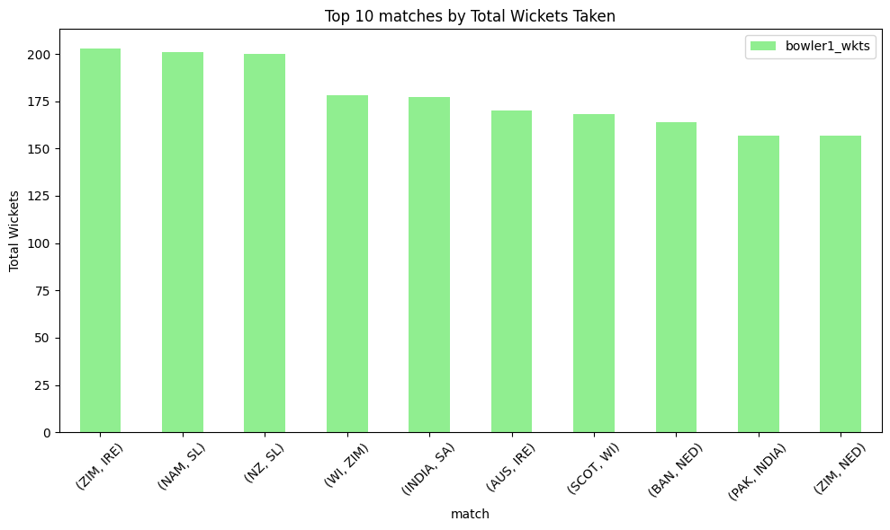
Top 10 Matches by Total Wickets
Similar to the previous visualization, we present the top 10 matches by total wickets taken.
This helps us understand matches with significant wicket-taking activity.

Slide 8
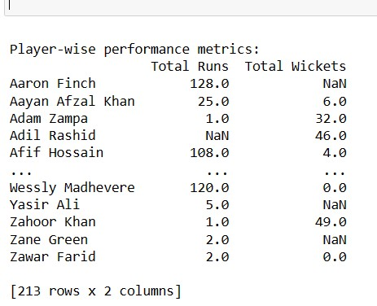
Player-wise Performance
Player-wise performance metrics are analyzed, focusing on leading run-scorers and wicket-takers.
We highlight standout players and their contributions to their respective teams.

Slide 9
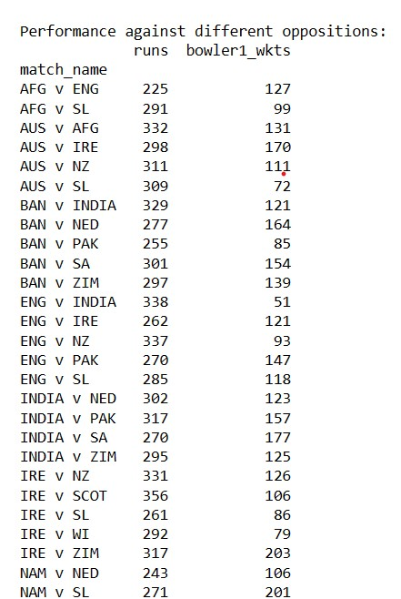
Performance Against Different Oppositions
We examine performance metrics against different oppositions, identifying trends in runs scored and wickets taken.
This analysis provides insights into teams' performances against specific opponents

Slide 10
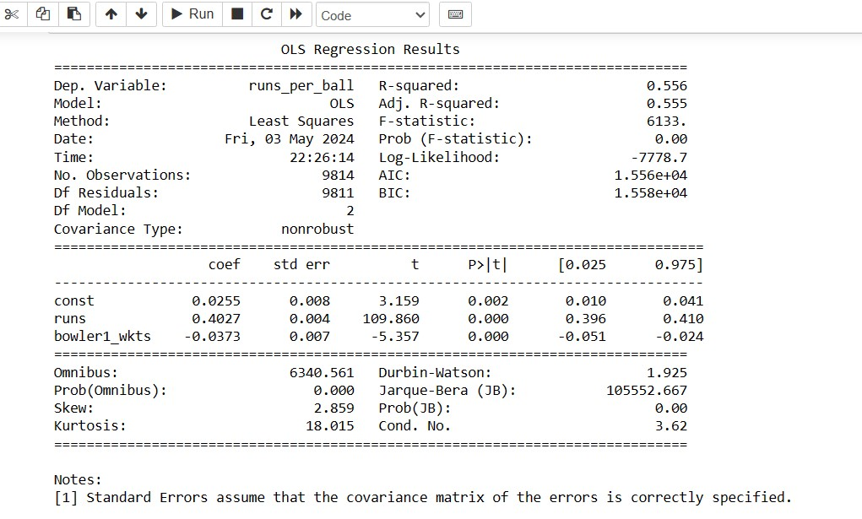
Regression Analysis
Regression analysis is conducted to understand the relationship between runs, wickets, and runs per ball.
We interpret the regression model results and discuss the implications for batting and bowling strategies.

Slide 11
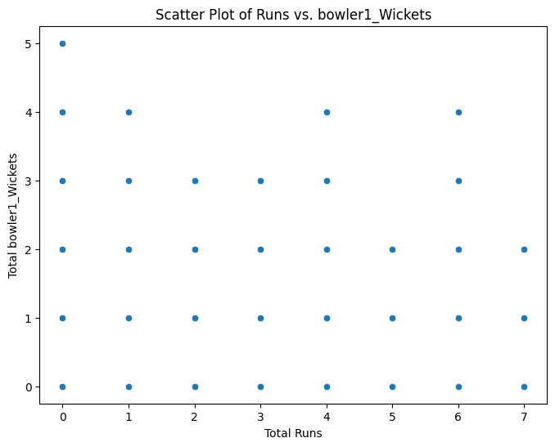
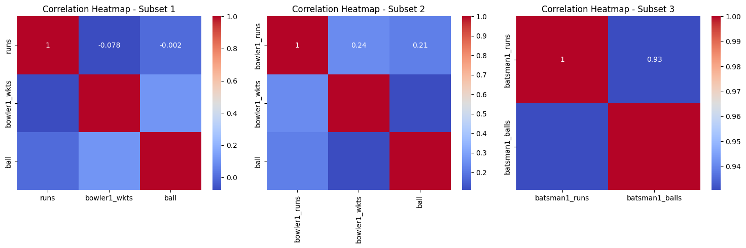
Additional Visualizations

Slide 12
Conclusion:
The analysis provides valuable insights into team and player performances during the T-20 World Cup 2022.
Key findings include identifying top-performing teams, standout players, and critical match events such as runs scored and wickets taken.
Visualizations such as bar plots and heatmaps aid in understanding data patterns and relationships.
Further analysis and exploration can be done to delve deeper into specific aspects of the dataset and uncover more insights.

Slide 13
Thank You for listening

